Slide 1

GLOBAL INSTITUTE OF TECHNOLOGY
Department of
Computer Science & Engineering
Subject Name with code: Data Structure & Algorithms
Unit-1
Presented by: Mr. Sohan Lal Gupta
Assistant Professor, CSE

Slide 2
GLOBAL INSTITUTE OF TECHNOLOGY JAIPUR
Data Structure & Algorithms
CSE/ III Sem
Index
1.1 Basic Stack
1.2 Stack Operations
1.2.1 algorithms for push
1.2.2 algorithms for pop
Sohan Gupta

Slide 3
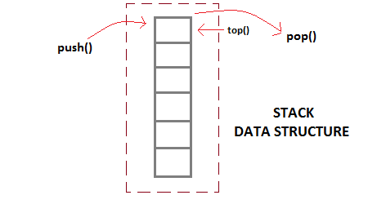
1.1 BASIC STACK
GLOBAL INSTITUTE OF TECHNOLOGY JAIPUR
Data Structure & Algorithms
CSE/ III Sem
Stack is a linear data structure which follows a particular order in which the operations are performed. The order may be LIFO(Last In First Out) or FILO(First In Last Out).
The elements are removed from a stack in the reverse order of that in which they were inserted into the stack.
example – a deck of cards or a pile of plates, etc.
Sohan Gupta

Slide 4
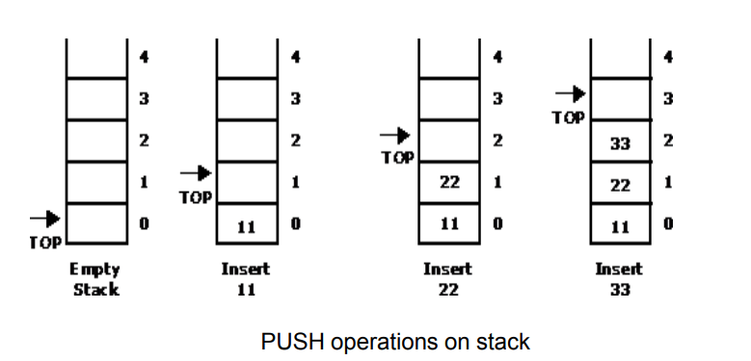
1.2 STACK OPERATION
GLOBAL INSTITUTE OF TECHNOLOGY JAIPUR
Data Structure & Algorithms
CSE/ III Sem
PUSH
POP
1.2.1 PUSH
Sohan Gupta

Slide 5
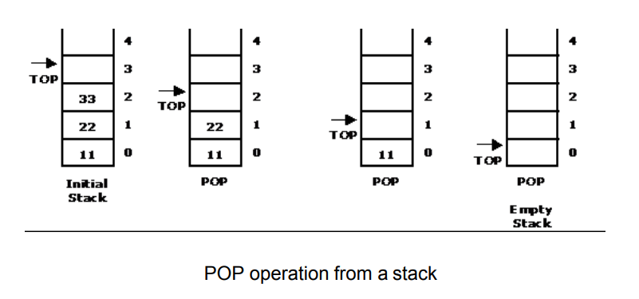
1.2.2 POP
GLOBAL INSTITUTE OF TECHNOLOGY JAIPUR
Data Structure & Algorithms
CSE/ III Sem
Sohan Gupta

Slide 6
Standard Error Messages in Stack
GLOBAL INSTITUTE OF TECHNOLOGY JAIPUR
Data Structure & Algorithms
CSE/ III Sem
Two standard error messages of stack are
– Stack Overflow: If we attempt to add new element beyond the maximum size, we will encounter a stack overflow condition.
– Stack Underflow: If we attempt to remove elements beyond the base of the stack, we will encounter a stack underflow condition.
Sohan Gupta

Slide 7
Algorithms for PUSH
GLOBAL INSTITUTE OF TECHNOLOGY JAIPUR
Data Structure & Algorithms
CSE/ III Sem
PUSH (STACK, TOP, MAXSIZE, ITEM):
This procedure pushes an ITEM onto a stack
1. If TOP = MAXSIZE, then Print: OVERFLOW, and Return.
2. Set TOP := TOP + 1 [Increases TOP by1]
3. Set STACK [TOP] := ITEM. [Insert ITEM in TOP position]
4. Return
Sohan Gupta

Slide 8
Algorithms for POP
GLOBAL INSTITUTE OF TECHNOLOGY JAIPUR
Data Structure & Algorithms
CSE/ III Sem
POP (STACK, TOP, ITEM):
This procedure deletes the top element of STACK and assign it to the variable ITEM
1. If TOP = 0, then Print: UNDERFLOW, and Return.
2. Set ITEM := STACK[TOP]
3. Set TOP := TOP - 1 [Decreases TOP by1]
4. Return
Sohan Gupta

Slide 9
#include<stdio.h>
#include<process.h>
#include<stdlib.h>
#define MAX 5 //Maximum number of elements that can be stored
int top=-1,stack[MAX];
void push();
void pop();
void display();
void main()
{
int ch;
while(1) //infinite loop, will end when choice will be 4
{
printf("\n*** Stack Menu ***");
printf("\n\n1.Push\n2.Pop\n3.Display\n4.Exit");
printf("\n\nEnter your choice(1-4):");
scanf("%d",&ch);

Slide 10
switch(ch)
{
case 1: push();
break;
case 2: pop();
break;
case 3: display();
break;
case 4: exit(0);
default: printf("\nWrong Choice!!");
}
}
}
void push()
{
int val;
if(top==MAX-1)
{
printf("\nStack is full!!");
}
else
{
printf("\nEnter element to push:");
scanf("%d",&val);
top=top+1;
stack[top]=val;
}
}

Slide 11
void pop()
{
if(top==-1)
{
printf("\nStack is empty!!");
}
else
{
printf("\nDeleted element is %d",stack[top]);
top=top-1;
}
}
void display()
{
int i;
if(top==-1)
{
printf("\nStack is empty!!");
}
else
{
printf("\nStack is...\n");
for(i=top;i>=0;--i)
printf("%d\n",stack[i]);
}
}

Slide 12
Output: *** Stack Menu ***
1.Push 2.Pop 3.Display 4.Exit
Enter your choice(1-4):1
Enter element to push:3 *** Stack Menu ***
1.Push 2.Pop 3.Display 4.Exit
Enter your choice(1-4):1
Enter element to push:6 *** Stack Menu ***
1.Push 2.Pop 3.Display 4.Exit
Enter your choice(1-4):3
Stack is…
6
3
*** Stack Menu ***
1.Push 2.Pop 3.Display 4.Exit
Enter your choice(1-4):2
Deleted element is 6 *** Stack Menu ***
1.Push 2.Pop 3.Display 4.Exit

Slide 13
Enter your choice(1-4):3
Stack is…
3
*** Stack Menu ***
1.Push 2.Pop 3.Display 4.Exit
Enter your choice(1-4):2
Deleted element is 3
*** Stack Menu ***
1.Push 2.Pop 3.Display 4.Exit
Enter your choice(1-4):2
Stack is empty!!

Slide 14
GLOBAL INSTITUTE OF TECHNOLOGY JAIPUR
Data Structure & Algorithms
CSE/ III Sem
Thank You… .
Any Quries ?
Sohan Gupta

